Slide 1
AC Power
By Matthew Ernst

Slide 2
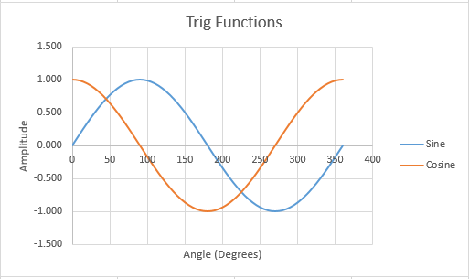
About AC Power
Alternating Current (AC), unlike DC Current, can change direction and voltage by using a transformer and can be used for all purposes
It has a 360 degree angular motion; maximum positive at 90, maximum negative at 270, 0 at 180 (sine)
0 at 90 and 270; maximum at 180 (cosine)

Slide 3
Radians and Degrees
Degrees to Radians: (D/180)*π
Radians to Degrees: (R*180)/π
Amplitude constantly varies in value and follows the sine function and direction periodically reverses
Period: time required to complete a full cycle (16.67 milliseconds)
Frequency: number of cycles in a second (60 Hertz)
Alternation: half a sine wave

Slide 4
AC Measurements
Peak: Ip or Vp, Peak-to-Peak = 2 x Vp
Average = 0.6374 x Vp, Effective: rms, 0.707 x Vp
Instantaneous: v=Vp sin θ
In Phase: when two voltages or currents have the same frequency and pass through zero and reach their maximums at the same time
Out of Phase: when two voltages or currents are the same frequency but pass through zero and reach their maximums at different times

Slide 5
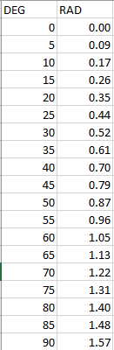
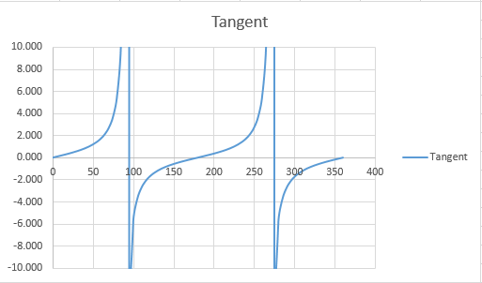
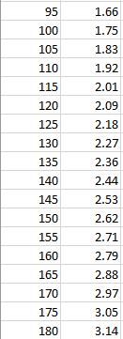
Tangent Function/degree-radian relationship

